Slide 1
Small satellite UHF identification and TT&C radio beacon
Solar Panels
RFM96 Lora Radio Module
Microprocessor
Power Storage
Power Regulation

Slide 2
Adafruit Feather 32U4 with RFM96 LoRa Radio
5V
Adafruit Feather
with 32U4 processor
RFM96 Lora
Radio Module
4
RESET
7
DIO0
8
NSS
13
SCK
11
MOSI
12
MISO
GND
GND

Slide 3
Arduino Pro Mini with RFM96 LoRa Radio on the Red PCB Board or Breadboard
Tester resistor
3.3 V
5-6 V
Power Storage
RAW
Vcc
RESET
ANT
4
2
DIO0
10
NSS
13
SCK
Capacitor-Based storage
11
MOSI
Silicon solar panels
12
MISO
GND
GND
Arduino Pro Mini
RFM96 Lora radio

Slide 4
Arduino Pro Mini with RFM96 LoRa Radio on the Red PCB Board or Breadboard
Supply voltage
5 V
5 V
3.3 V
Voltage potential
Tester resistor
RAW
Vcc
ANT
RAW
Vcc
RESET
ANT
4
RESET
4
2
DIO0
2
DIO0
10
NSS
10
NSS
13
SCK
13
SCK
11
MOSI
11
MOSI
12
MISO
12
MISO
GND
GND
GND
GND
Arduino Pro Mini
RFM96 Lora radio
Arduino Pro Mini
RFM96 Lora radio

Slide 5
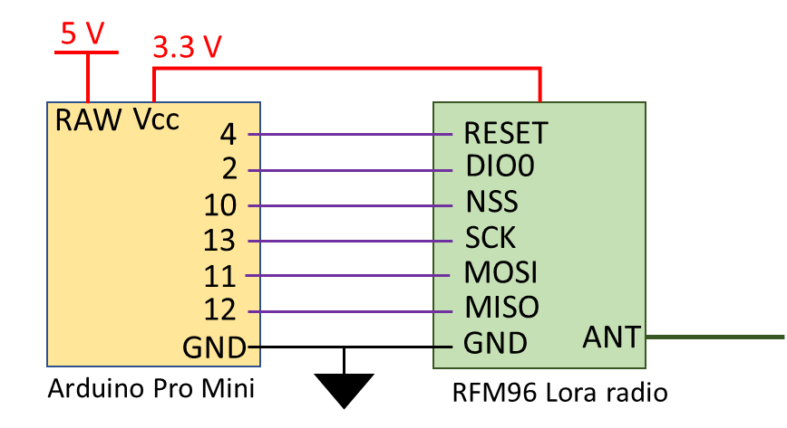
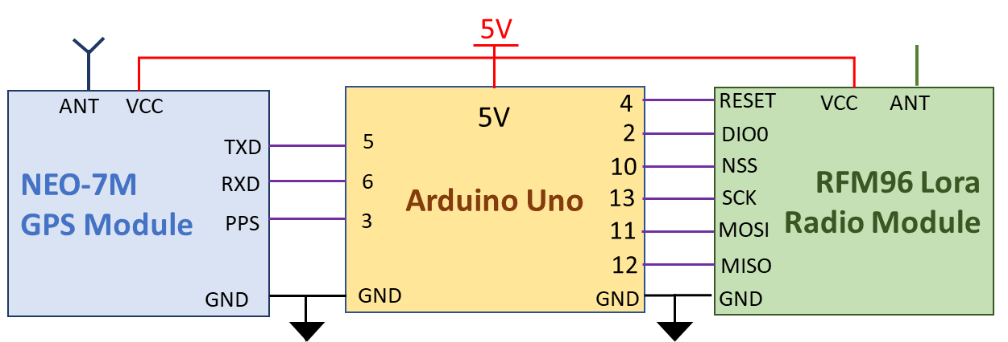
Satellite Radio Beacon
Ground receiving station #1
Ground receiving station #2

Slide 6
Arduino Pro Mini with RFM96 LoRa Radio on the Red PCB Board or Breadboard
Supply voltage
Voltage potential
Tester resistor
RAW or Vcc
Arduino Pro Mini

Slide 7
Arduino Uno with RFM96 LoRa Radio and Ublox GY-NEO6MV2 GPS module
5V
ANT
VCC
4
RESET
VCC
ANT
NEO-7M
GPS Module
Arduino Uno
RFM96 Lora
Radio Module
5V
2
TXD
5
DIO0
6
10
NSS
RXD
13
SCK
PPS
3
11
MOSI
12
MISO
GND
GND
GND
GND

Slide 8
TX Radio
5dBm TX power
1.31dB
1.80dB
1.33dB
1.31dB
1.31dB
RX Radio
5dBm TX power
30dB
30dB
20dB
8dB
A
30dB
TX Radio
10dBm TX power
1.31dB
1.80dB
1.33dB
1.31dB
1.31dB
RX Radio
10dBm TX power
30dB
30dB
20dB
15dB
A
30dB
TX Radio
15dBm TX power
1.31dB
1.80dB
1.33dB
1.31dB
1.31dB
RX Radio
15dBm TX power
30dB
30dB
20dB
15dB
A
30dB
TX Radio
20dBm TX power
1.31dB
1.80dB
1.33dB
1.31dB
1.31dB
RX Radio
20dBm TX power
30dB
30dB
20dB
15dB
A
30dB
TX Radio
5dBm TX power
1.31dB
1.80dB
1.33dB
1.31dB
1.31dB
RX Radio
5dBm TX power
30dB
30dB
20dB
15dB
A
30dB

Slide 9
TX Radio
Output = TX power
1.31dB
1.80dB
1.33dB
1.31dB
1.31dB
RX Radio
30dB
30dB
20dB
A
B
30dB

Slide 10
RFM96 Breakout board Schematic
Antenna SMA plug
DIO5
Ant
RFM96
Module
RST
DIO3
NSS
DIO4
SCK
3.3V
MOSI
DIO0
MISO
DIO1
GND
DIO2

Slide 11
Full satellite radio beacon system
LM3671 Buck converter
3.3V
Tester resistor
Vin
3.3V
5.5 - 6.3V
GND
4
RESET
ANT
2
DIO0
10
NSS
13
SCK
+
1F
+
1F
+
1F
+
1F
+
1F
11
MOSI
12
MISO
GND
GND
Silicon solar panel
Super-capacitor storage
Arduino Pro Mini
RFM96 LoRa radio module

Slide 12
Full satellite radio beacon system
Tester resistor
Power regulator
5V power supply
3.3V
Vin
3.3V
GND
4
RESET
ANT
2
DIO0
10
NSS
13
SCK
11
MOSI
12
MISO
GND
GND
Arduino Pro Mini
RFM96 LoRa radio module

Slide 13










Satellite
Radio
Beacon
$$L_{ft}$$
$$P_{amp}$$
$$G_{t}$$
$$EIRP$$
$$L_{fs}$$
$$L_{a}$$
$$G_{r}$$
Ground
Receiving
Station
$$C′$$
$$\frac{G}{T_{e}}\text{⇒}\frac{C}{N},\frac{C}{N_{0}},\frac{E_{b}}{N_{0}}$$
2000kms
$$L_{fr}$$

Slide 14
Satellite launch
Processor and radio initialises
System Power Down - 30 Minutes
Collect Data
Transmit Data
Enter RX Mode – 30 seconds
Perform CMD operation if required
System Power down – 4-5 Minutes

Slide 15
Satellite launch
Processor and radio initialises
System Power Down - 30 Minutes
Collect Data
Check Battery Voltage
Check Solar Panel Current
Transmit Data
Perform any other checks
Check Light sensing Diodes
Enter RX Mode - 1 minute
Perform CMD operation if required
System Power down – 4-5 Minutes

Slide 16


Slide 17


Slide 18
